Slide 1



ML Summer School
Industrial Training

Slide 2

OUR CONTENT
Supervised Learning
1
2
Deep Neural Networks
Dimensionality Reduction
3
4
Unsupervised Learning

Slide 3
OUR CONTENT
Probabilistic Graphical Models
5
6
Sequential Learning
Casual Inference
7
8
Reinforcement Learning

Slide 4
Before We Started
Unsupervised Learning
Use unlabeled datasets to train an algorithm
Supervised Learning
Use labeled datasets to train an algorithm
Reinforcement Learning
Hit and trial to train an algorithm

Slide 5
SUPERVISED LEARNING
01

Slide 6

Supervised Learning
Supervised learning, as the name indicates, has the presence of a supervisor as a teacher. Basically supervised learning is when we teach or train the machine using data that is well labelled. Which means some data is already tagged with the correct answer. After that, the machine is provided with a new set of examples(data) so that the supervised learning algorithm analyses the training data(set of training examples) and produces a correct outcome from labelled data.

Slide 7
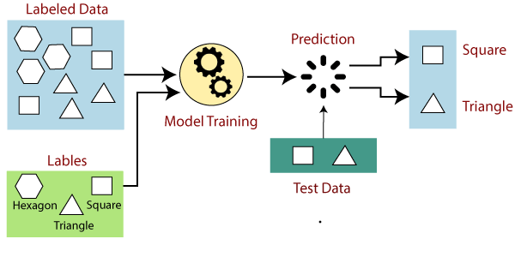

Slide 8
DEEP NEURAL NETWORKS
02

Slide 9
Deep Neural Networks
A deep neural network (DNN) is an ANN with multiple hidden layers between the input and output layers. Similar to shallow ANNs, DNNs can model complex non-linear relationships.
The main purpose of a neural network is to receive a set of inputs, perform progressively complex calculations on them, and give output to solve real world problems like classification. We restrict ourselves to feed forward neural networks.

Slide 10
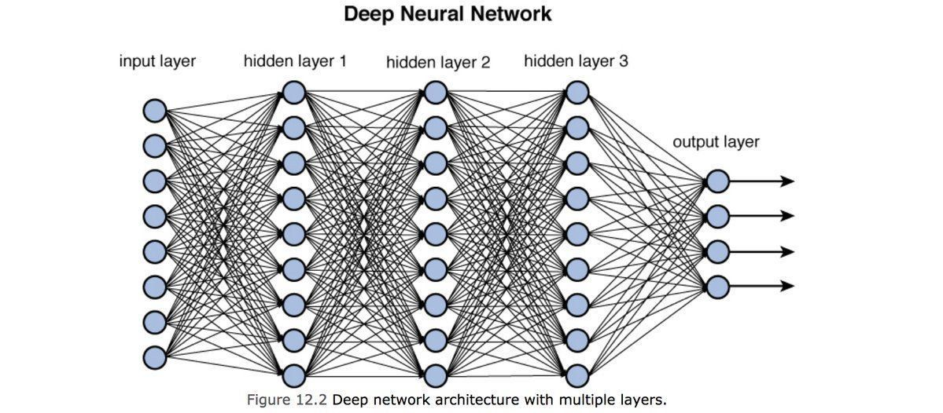

Slide 11
DIMENTIONALITY REDUCTION
03

Slide 12
Dimensionality Reduction
In machine learning classification problems, there are often too many factors on the basis of which the final classification is done. These factors are basically variables called features. The higher the number of features, the harder it gets to visualize the training set and then work on it. Sometimes, most of these features are correlated, and hence redundant. This is where dimensionality reduction algorithms come into play. Dimensionality reduction is the process of reducing the number of random variables under consideration, by obtaining a set of principal variables. It can be divided into feature selection and feature extraction.

Slide 13
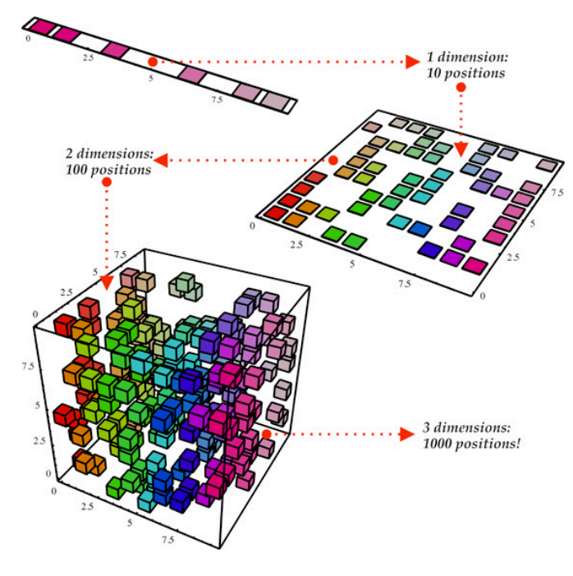

Slide 14
UNSUPERVISED LEARNING
04

Slide 15
Unsupervised Learning
As the name suggests, unsupervised learning is a machine learning technique in which models are not supervised using training dataset. Instead, models itself find the hidden patterns and insights from the given data. It can be compared to learning which takes place in the human brain while learning new things. It can be defined as:
“Unsupervised learning is a type of machine learning in which models are trained using unlabeled dataset and are allowed to act on that data without any supervision.”

Slide 16
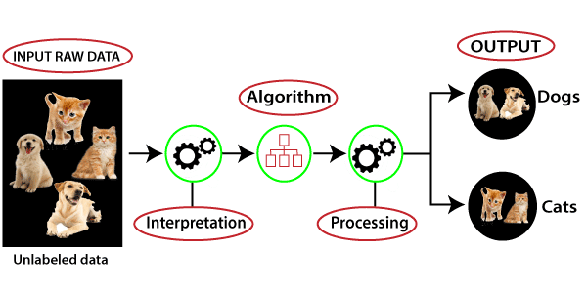

Slide 17
PROBABLISTIC GRAPHICAL MODEL
05

Slide 18
Probabilistic Graphical Model
Statistical models that encode complex joint multivariate probability distributions using graphs. In other words, PGMs capture conditional independence relationships between interacting random variables. This is beneficial since a lot of knowledge on graphs has been gathered over the years in various domains, especially on separating subsets, cliques and functions on graphs. This knowledge can be reused in PGMs. Furthermore, one can easily visualize PGMs and get a quick overview of the model structure.

Slide 19
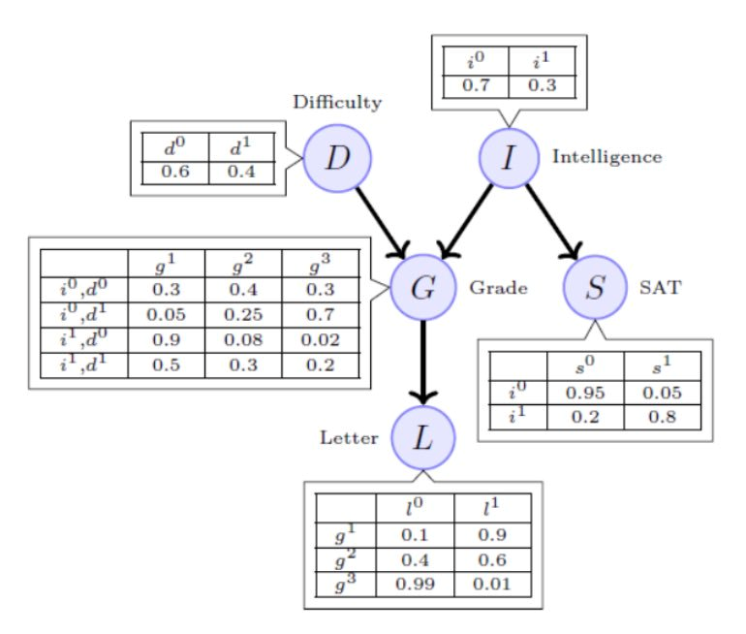

Slide 20
SEQUENTIAL LEARNING
06

Slide 21
Sequential Learning
Machine learning models that input or output data sequences are known as sequence models. Text streams, audio clips, video clips, time-series data, and other types of sequential data are examples of sequential data. Recurrent Neural Networks (RNNs) are a well-known method in sequence models. The analysis of sequential data such as text sentences, time-series, and other discrete sequence data prompted the development of Sequence Models. These models are better suited to handle sequential data, whereas Convolutional Neural Networks are better suited to treat spatial data.

Slide 22
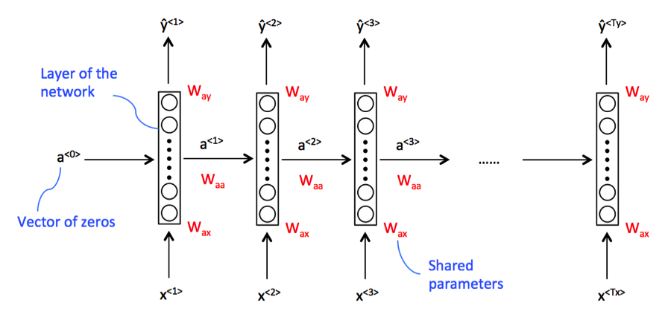

Slide 23
Causal Inference
07

Slide 24
Causal Inference
Causality influence by which one event, process or state, a cause, contributes to the production of another event, process or state, an effect, where the cause is partly responsible for the effect, and the effect is partly dependent on the cause. First of all, it is key to better define this term. As humans, we often think in terms of cause and effect — if we understand why something happened, we can change our behavior to improve future outcomes. In other words, our goal is trying to learn causality from data (what was the cause and what was the effect).

Slide 25
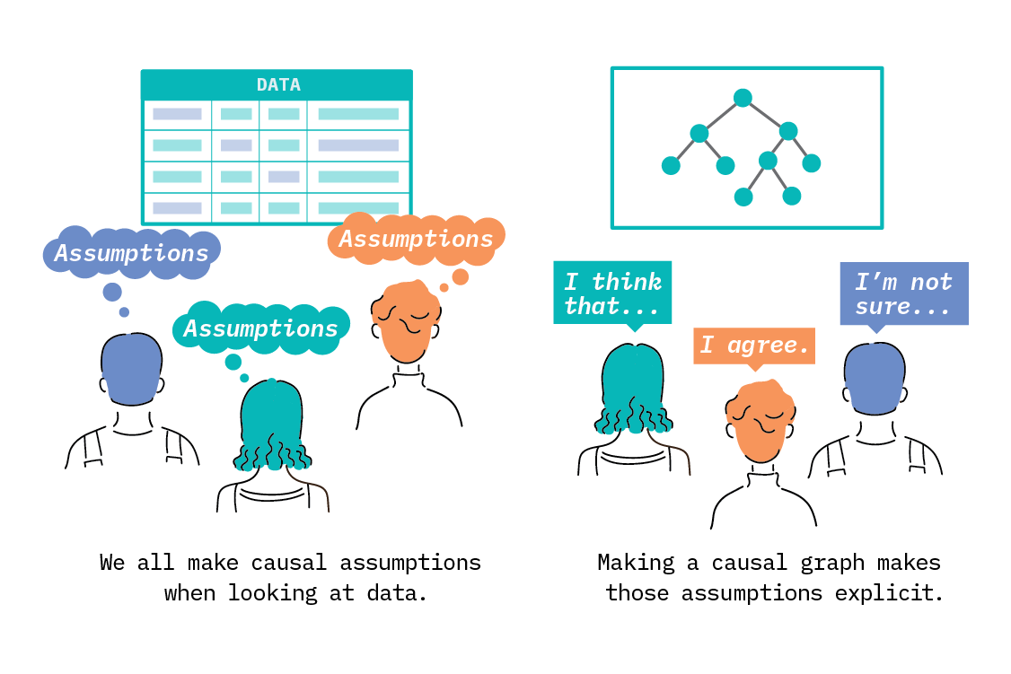

Slide 26
Reinforcement Learning
08

Slide 27
Reinforcement Learning
Reinforcement learning is an area of Machine Learning. It is about taking suitable action to maximize reward in a particular situation. It is employed by various software and machines to find the best possible behavior or path it should take in a specific situation. Reinforcement learning differs from supervised learning in a way that in supervised learning the training data has the answer key with it so the model is trained with the correct answer itself whereas in reinforcement learning, there is no answer but the reinforcement agent decides what to do to perform the given task. In the absence of a training dataset, it is bound to learn from its experience.

Slide 28
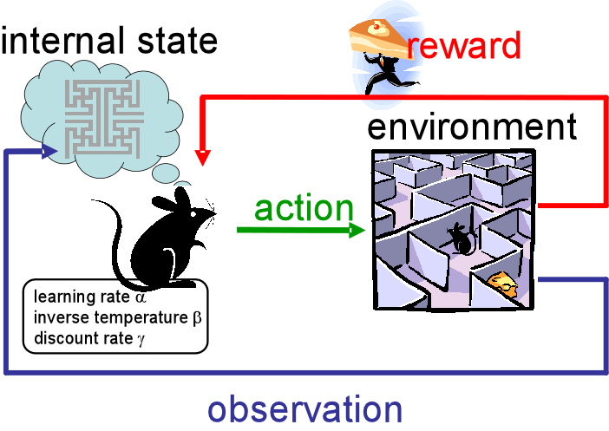

Slide 29

“Predicting the future isn’t magic, it’s artificial intelligence”

Slide 30


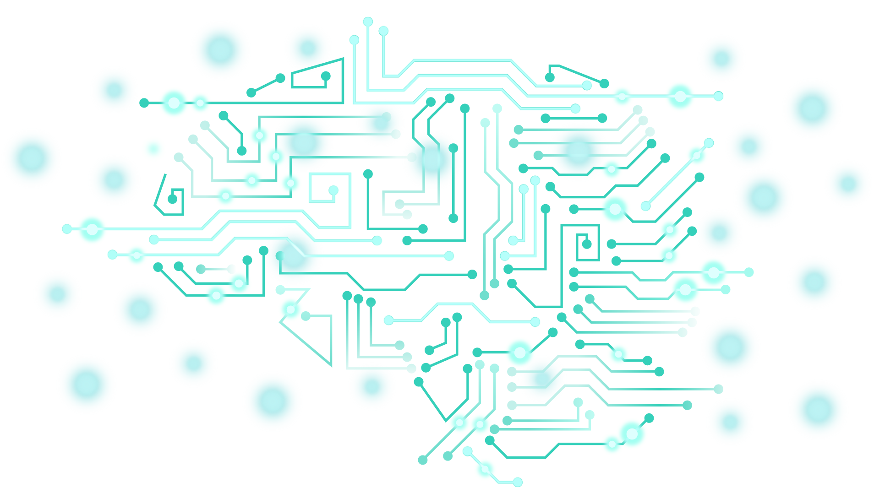
THANKS!

